Slide 1
Building and Deploying Your First Servlet

Slide 2
Creating a Basic Servlet-Hello World!

Slide 3
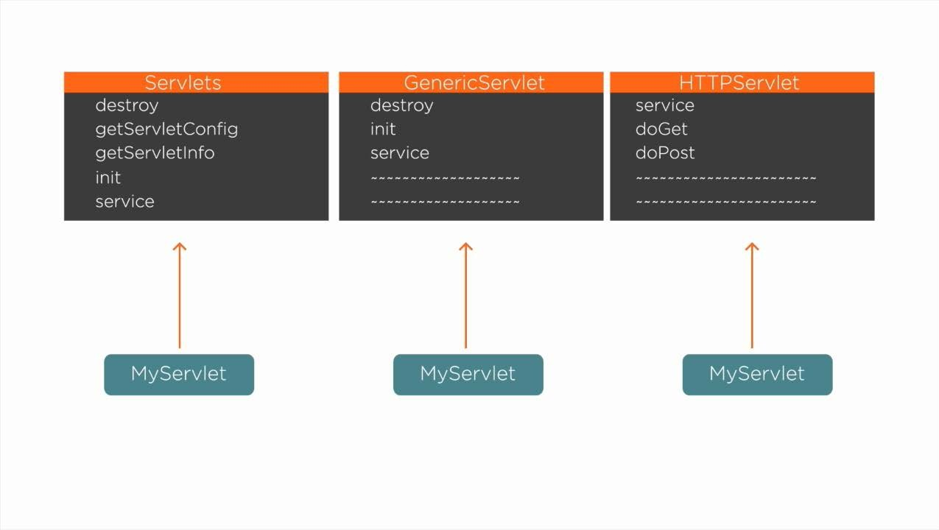

Slide 4
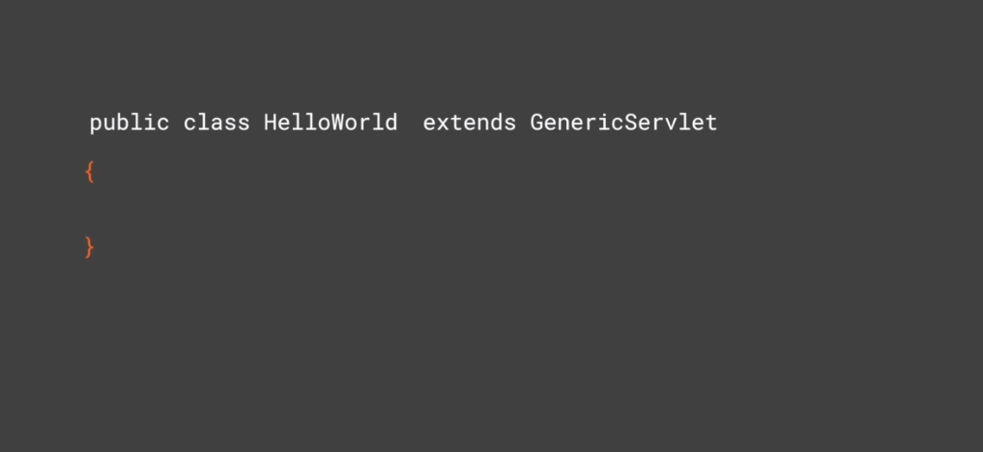

Slide 5
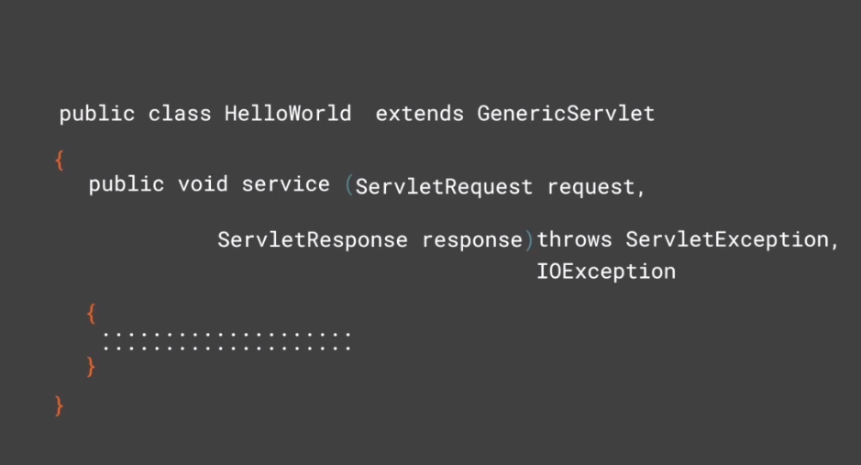

Slide 6
Creating a Basic Servlet-Hello World !
Deploying Servlet in Web Server

